Slide 1
Linear Systems 5: Methods for Special Matrices
AMSC/CMSC 460
dr. Christopher Moakler

Slide 2
Review from last lecture
We looked at sources of for both the direct and iterative methods we’ve previously studied.
For Gaussian Elimination, and the related methods, there is an issue with very small values in the pivot position called “swamping”
The small pivot values lead to a loss of precision and lead to erroneous results with finite memory.
To overcome this problem, we introduce pivoting.
Pivoting involves moving the row with the largest element in the current column into the pivot position.
This allows us to always multiply by a number lass than 1.

Slide 3
Review from last lecture cntd
We also discussed an issue that affect both direct and iterative methods, ill-conditioning.
If a matrix is ill-conditioned, the solution is very sensitive to changes in the values of the matrix or the RHS vector.
We derived the condition number to be,
$$κ(A)= \left\|A\right\|\left\|A^{−1}\right\|$$
If the condition number is not much larger than 1, the system is well-conditioned.
Slight changes to the elements won’t lead to large changes in the solution vector x.
If the condition number is much larger than 1, the system is ill-conditioned.
Slight changes to the elements will lead to large changes in the solution vector x.
If the condition number is infinite, the system is ill-posed and the matrix A is singular.
Small condition number – good
Large condition number – bad

Slide 4
Condition number
Typically when you see a discussion of the condition number, it’s in reference to the L2-norm version.
To calculate the condition number exactly, you need to compute the inverse of Matrix A.
This can be costly but may be worthwhile since it can tell you whether your problem is ill-conditioned or not.
There are methods to approximate the condition number as well.
For example “condest” in Matlab which approximates the inverse of a matrix.
The Matlab documentation page has more information about this.
You can also calculate the condition number using
$$κ\left(A\right)=\frac{σ_{max}}{σ_{min}}$$
Where $σ_{max/min}$ are the maximum and minimum singular values of the matrix A.

Slide 5
Example of an ill-conditioned matrix
I’m stealing this example from a blogpost by Cleve Moler.
https://blogs.mathworks.com/cleve/2017/07/17/what-is-the-condition-number-of-a-matrix/
His blog is pretty interesting, you should check it out.
Take the equation,
$$\left[\begin{matrix}4.1 & 2.8 \\ 9.7 & 6.6\end{matrix}\right]x=\left[\begin{matrix}4.1 \\ 9.7\end{matrix}\right]$$
The solution to this is simply, $x=\left[\begin{matrix}1 \\ 0\end{matrix}\right]$ and a computer will calculate this just fine.
If we change the first element of b even slightly, say by 0.01, we get a very different solution!
$$\left[\begin{matrix}4.1 & 2.8 \\ 9.7 & 6.6\end{matrix}\right]x=\left[\begin{matrix}4.11 \\ 9.7\end{matrix}\right]$$
The solution is now $x≈\left[\begin{matrix}0.3400 \\ 0.9700\end{matrix}\right]$

Slide 6
Example of an ill-conditioned matrix
This is not an issue with the computer and floating point inaccuracies.
You can confirm the solution yourself by hand!
This is an actual feature of the matrix and its inverse.
You can find an inverse and a solution to an ill-conditioned matrix without issue.
The problem arises when a matrix is so ill-conditioned that any slight rounding error causes large changes our final answers.
This also isn’t just an issue with floating point operations!
If you’re using real world data and your matrix is ill-conditioned, you can run into issues if your data has precision issue or any noise at all.

Slide 7
Condition number is a feature of the Matrix
I again want to stress this,
The condition number of a Matrix is not an effect you can overcome with a different algorithm. IT IS INHERENT TO THE MATRIX.

Slide 8
Methods for specific Matrices
With certain matrices, we have developed very efficient algorithms to solve the Ax = b question.
An obvious example is if the matrix is triangular, we can simply perform a backward/forward substitution.
We will look at other special cases, namely:
Tridiagonal matrices
Symmetric Positive Definite Matrices

Slide 9
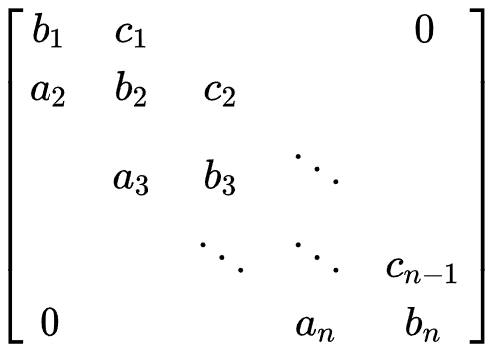
Tridiagonal Matrices
Recall, a tridiagonal matrix is a matrix of the form
Tridiagonal matrices are especially efficient to solve requiring only $O\left(n\right)$ operations.
You can also store the entire matrix in only 3n-2 elements.
Due to the structure, it is a simple procedure to put the matrix into an upper triangular form and backsolve.

Slide 10
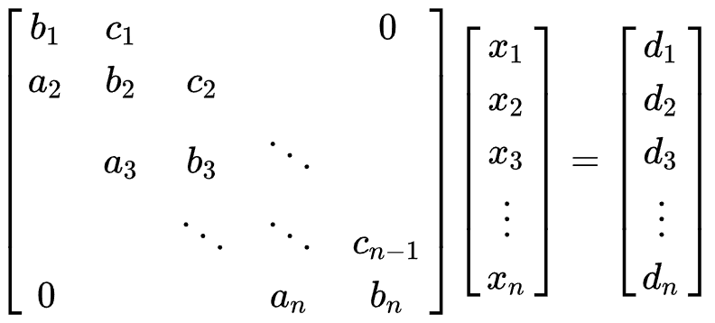
Thomas Algorithm
The primary method for solving a system of the form
is a simplified form of Gaussian Elimination.
We endeavor to put the system in a form where there are 1s on the main diagonal, elements $c_{i}′$ on the first off diagonal, and 0s everywhere else.
We also modify the RHS vector and backsolve from there.

Slide 11
Thomas Algorithm algorithm
We begin with a forward sweep:
$c_{1}^{′}=\frac{c_{1}}{b_{1}}$
$$d_{1}^{′}= \frac{d_{1}}{b_{1}}$$
for i = 2:n-1
$c_{i}^{′}=\frac{c_{i}}{b_{i}−a_{i}c_{i−1}^{′}}$
$d_{i}^{′}=\frac{d_{i}−a_{i}d_{i−1}^{′}}{b_{i}−a_{i}c_{i−1}^{′}}$
end
$${d′}_{n}= \frac{d_{n}−a_{n}d_{n−1}^{′}}{b_{n}−a_{n}c_{n−1}^{′}}$$

Slide 12
Thomas Algorithm algorithm contd
The solution is then obtained via back substitution:
$$x_{n}=d_{n}^{′}$$
for n-1:1
$x_{i}={d′}_{i}−{c′}_{i}x_{i+1}$
end

Slide 13
Thomas Algorithm complexity
The Thomas Algorithm is very efficient requiring $O\left(n\right)$ operations.
The typical Gaussian Elimination requires $O\left(n^{3}\right)$.
It is also very efficient in terms of memory requirements.
For a sparse matrix, Gaussian Elimination can often introduce many non-zero values that were not previously present.
For the tridiagonal system, we only need to store the original 3n-2 nonzero elements and an additional 2n-1 elements for the c’ and d’ terms.
There are also algorithms that don’t retain the original coefficients and further reduce the memory requirements.

Slide 14
Symmetric Positive Definite Matrices
Symmetric positive definite matrices are a special type of matrix that arise in various physical systems.
The defining characteristics of a symmetric positive definite matrix are that they are symmetric and positive definite!
Symmetric means simply $A^{T}=A$
Positive definite is more complicated.
A matrix is positive definite if $x^{T}Ax>0 ∀x≠0$.
SPD matrices have other useful properties
A square matrix is SPD iff all eigenvalues are real and positive.
If A is an SPD nxn matrix and X is an nxm matrix of full rank, $X^{T}AX$ is mxm and SPD.
All principal submatrices of an SPD matrix are SPD.

Slide 15
Symmetric Positive Definite Matrix Factorization
SPD matrices have a very simple decomposition.
$A=LL^{T}$
The properties on the previous slide allow us to generate the matrix $L^{T}$ very easily.
The method is named after André-Louis Cholesky a French mathematician and soldier who died a few months before the end WWI.
His method was published posthumously.

Slide 16
Cholesky Factorization 2 x 2 case
For a 2 x 2 matrix,
$$\left[\begin{matrix}a & b \\ c & d\end{matrix}\right]$$
The factorization into $LL^{T}$ must take the form
$$\left[\begin{matrix}a & b \\ c & d\end{matrix}\right]=\left[\begin{matrix}\sqrt{a} & 0 \\ u & v\end{matrix}\right]\left[\begin{matrix}\sqrt{a} & u \\ 0 & v\end{matrix}\right]=\left[\begin{matrix}a & u\sqrt{a} \\ u\sqrt{a} & u^{2}+v^{2}\end{matrix}\right]$$
From here, we can identify the values of u and v
$$A= \left[\begin{matrix}a & b \\ c & d\end{matrix}\right]=\left[\begin{matrix}\sqrt{a} & 0 \\ b/{\sqrt{a}} & \sqrt{c−{b^{2}}/a}\end{matrix}\right]\left[\begin{matrix}\sqrt{a} & b/{\sqrt{a}} \\ 0 & \sqrt{c−{b^{2}}/a}\end{matrix}\right]=L^{T}L$$
We have a Cholesky decomposition for the 2 x 2, now we just need it for the n x n case!

Slide 17
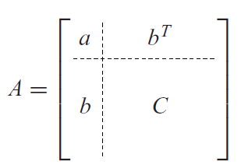
Cholesky Factorization Example
Let’s find the Cholesky decomposition of $\left[\begin{matrix}4 & −2 & 2 \\ −2 & 2 & −4 \\ 2 & −4 & 11\end{matrix}\right]$
We start by finding the first row by computing $L_{11}^{T}=\sqrt{a_{11}}$ and $L_{1,2:3}^{T}=A_{1,2:3}/L_{11}^{T}$.
This is just like the 2x2 case where the first element was $\sqrt{a_{11}}$ and the rest of the row was $b/\sqrt{a}$, this time b is a row vector though.
So, we get the first row is
$\left[\begin{matrix}2 & −1 & 1 \\ & & \\ & & \end{matrix}\right]$
Sauer

Slide 18
Cholesky Factorization Example Contd
The rest of the matrix comes by finding $A_{1}=C−uu^{T}$ where $u^{T}=b^{T}/\sqrt{a}$.
The term $uu^{T}$ is an outer product.
In this example $u^{T}=\left[−1 1\right]$ so the outer-product is $\left[\begin{matrix}−1 \\ 1\end{matrix}\right]\left[−1 1\right]=\left[\begin{matrix}1 & −1 \\ −1 & 1\end{matrix}\right]$
while the submatrix C is $\left[\begin{matrix}2 & −4 \\ −4 & 11\end{matrix}\right]$
So,
$A_{1}=C−uu^{T}=\left[\begin{matrix}2 & −4 \\ −4 & 11\end{matrix}\right]−\left[\begin{matrix}1 & −1 \\ −1 & 1\end{matrix}\right]$ = $\left[\begin{matrix}1 & −3 \\ −3 & 10\end{matrix}\right]$
Our updated matrix $L^{T}$ is then
$$L^{T}=\left[\begin{matrix}2 & −1 & 1 \\ & 1 & −3 \\ & −3 & 10\end{matrix}\right]$$
Sauer

Slide 19
Cholesky Factorization Example Contd
Our updated matrix $L^{T}$ is then
$$L^{T}=\left[\begin{matrix}2 & −1 & 1 \\ & 1 & −3 \\ & −3 & 10\end{matrix}\right]$$
We continue the factorization in the updated 2 x 2 submatrix.
First we find the second row using $L_{22}^{T}=1$ and $L_{23}^{T}=−3$
$$L^{T}=\left[\begin{matrix}2 & −1 & 1 \\ & 1 & −3 \\ & & \end{matrix}\right]$$
The submatrix is $10−\left(−3\right)\left(−3\right)=1$ which we take the root of to complete the factorization.
$$L^{T}=\left[\begin{matrix}2 & −1 & 1 \\ 0 & 1 & −3 \\ 0 & 0 & 1\end{matrix}\right]$$

Slide 20
Cholesky Factorization Block Algorithm
You find the outer elements of $L^{T}$ first and work inwards.
You begin by partitioning the matrix
The 1,1 element is just the square root of $a_{11}$.
The rest of the row is found by dividing each remaining terms by $\sqrt{a_{11}}$.
You form the remainder of the matrix by computing $C−uu^{T}$ where $u^{T}=b^{T}/\sqrt{a}$.
This process is repeated until the final submatrix you form is 1 x 1 at which point you take the root of that element and you are done!
Sauer

Slide 21
Cholesky Factorization Algorithm
for i = 1:n
$L_{ii}^{T}=\sqrt{A_{ii}}$
$u^{T}=\frac{1}{L_{ii}^{T}}A_{i,i+1:n}$
$L_{i,i+1:n}^{T}=u^{T}$
$A_{i+1:n,i+1:n }=A_{i+1:n,i+1:n }−uu^{T}$
end
Here I’m using $A_{i,i+1:n}$ to represent a portion of the i^{th} row containing columns i+1 to n. To implement this in Matlab you could use the built-in colon notation or a for loop.

Slide 22
Using Cholesky Factorization to solve a linear system
Now that we can write $A$ as $LL^{T}$, we can solve the system $Ax=b$ in a straightforward manor.
$$Ax=LL^{T}x=b$$
We solve the lower triangular system $Lc=b.$
We then solve the upper triangular system $L^{T}x=c$ which is also easy to do.
Why do we use this method at all?
It requires $\frac{n^{3}}{3}+O\left(n^{2}\right)$ flops and n square roots to get the decomposition.
This is about twice as fast as an LU decomposition.

Slide 23
Conjugate Gradient Method
If A is SPD, the quadratic form,
$$f\left(x\right)= \frac{1}{2}x^{T}Ax−b^{T}x+c$$
is a function whose minimum is exactly the solution to $Ax=b$.
Why do we want to convert the simple question of solving a system of linear equations into what seems to be a much more complicated question of minimizing a function?
It’s really easy to get an approximate minimum and thus an approximate solution!

Slide 24
Conjugate Gradient Method Algorithm
I won’t go too deeply into the theory behind the algorithm.
If you’re interested Sauer and numerous websites discuss the theory behind it.
I will also post a useful pdf that gives some geometric intuition behind the method. It’s long so you don’t need to read it.
$$x_{0}=0$$
$$d_{0}=r_{0}=b−Ax_{0}$$
for i = 1:n-1
$α_{i}=\frac{r_{i}^{T}r_{i} }{d_{i}^{T}Ad_{i}}$
$x_{i+1}=x_{i}+α_{i}d_{i}$
$r_{i+1}=r_{i}+α_{i}Ad_{i}$
$β_{i+1}=\frac{r_{i+1}^{T}r_{i+1} }{r_{i}^{T}r_{i}}$
$d_{i+1}=r_{i+1}+β_{i}d_{i}$
if $r_{i}<tol$
break
end

Slide 25
Conjugate Gradient Method rationale
The conjugate gradient method is actually a direct method of solving the system of equations.
The minimization procedure looks in one direction and minimizes the function in that dimension.
It then moves to a new direction and minimizes the function in that dimension.
After it runs out of dimensions, the residual goes to zero and we’ve converged.
The name of the conjugate gradient method sums it up nicely:
Gradient because we use the gradient to minimize the function.
Conjugate because the direction we minimize in is the conjugate direction, meaning the residual moves in an orthogonal direction.

Slide 26
Conjugate Gradient Method iterative approach
Why use this over Gaussian Elimination?
For smaller matrices where we can still hope to utilize Gaussian elimination, CGM is three times slower than Gaussian Elimination.
However, if we have a large sparse matrix we can get a decent estimate of the solution in a few steps!
Gaussian elimination would need to go through all $\frac{n^{3}}{3}$ steps before it gets an answer.
So if it’s a direct method, why do we typically treat it as an iterative method?
If the system is very large, there may be a large number of dimensions that we need to search in.
Before we search in every direction, we may already have a very good approximation of the solution!

